Slide 1
Password Generator
Submitted by:
CHARVI BANSAL-2210990236

Slide 2

Index
Objective
Introduction
Problem statement
Methodology, Approach & Techniques
Source Code (screenshots)
Result
Conclusion
Reference

Slide 3


Objective
Creating a password generator project in Python serves multiple objectives, including:
Practical Application of Programming Concepts: Building a password generator allows you to apply various programming concepts such as random number generation, string manipulation, user input handling, and possibly GUI development if you choose to create a graphical interface.
Security Awareness: By understanding how passwords are generated and the importance of creating strong, unique passwords, you'll increase your awareness of cybersecurity best practices
.
Customization and Flexibility: You can tailor the password generator according to your preferences and requirements. You can add features such as specifying password length

Slide 4

Introduction
In today's digital age, the security of our online accounts is of paramount importance.
One fundamental aspect of securing our accounts is using strong and unique passwords.
However, generating such passwords manually can be cumbersome and error-prone. To address this challenge, we present a Python Password Generator project.
Our password generator will leverage the built-in ‘random’ module in Python to generate random characters and sequences.

Slide 5

Problem statement
Secure Password Generation: Develop a Python program to generate secure passwords with customizable length and complexity.
User Control: Allow users to specify password length and complexity preferences, including options for uppercase letters, lowercase letters, digits, and special characters.
Robustness and Security: Ensure randomness in password generation, implement a user-friendly interface, and consider security measures to safeguard the password generation process.

Slide 6
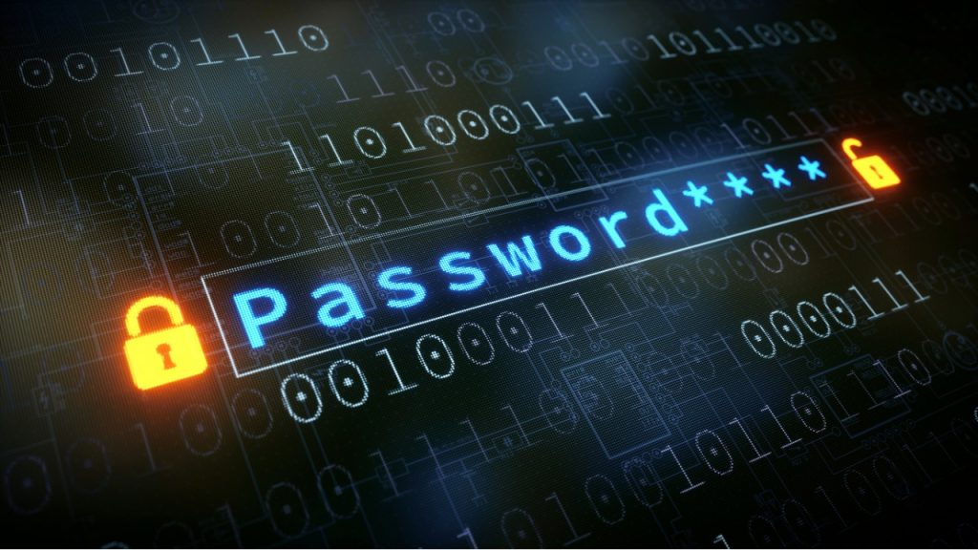
Methodology, Approach & Techniques
Requirement Analysis:
Conducted a thorough analysis of user requirements and expectations to define the scope and functionality of the password generator project.
Identified key features such as customizable password length, avoidance of ambiguous characters, and user-friendly interface.
Research and Planning:
Researched best practices in password generation, security guidelines, and Python libraries for randomization and string manipulation.
Created a detailed project plan outlining tasks, timelines, and resource requirements.

Slide 7
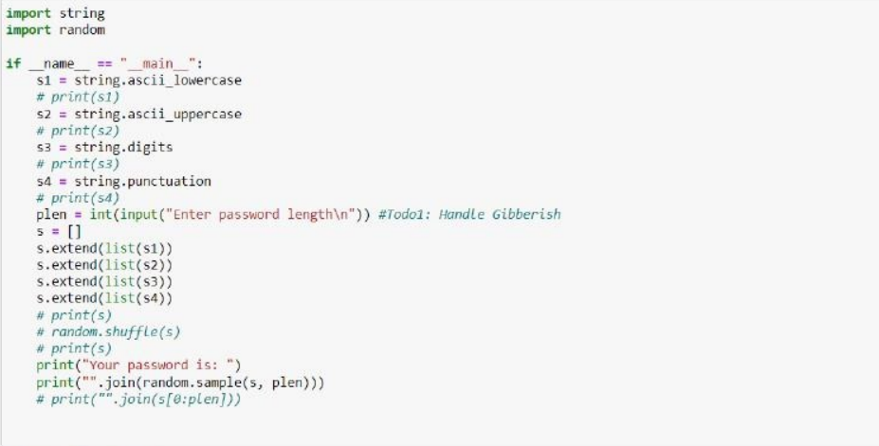
Source Code(screenshots)

Slide 8

Result

Slide 9

Conclusion
By developing this Python Password Generator project, we aim to empower users with a reliable tool for creating strong and unique passwords, thereby enhancing the security of their online accounts and digital assets.
Join us on this journey as we delve into the world of cybersecurity and Python programming to build a valuable and practical solution for password management.
Let's ensure that your digital identity remains safeguarded against unauthorized access!

Slide 10

Reference
W3Schools. (n.d.). python Tutorial. Retrieved from https://www.w3schools.com/python/
Github-www.github.com
Geek for geek-www.geekforgeek.com

Slide 11

The End

